Slide 1
CAMPUS MADNESS: STUDENT STRIKE FORCE
Save the University... Save the World!

Slide 2

INTRODUCTION

Slide 3
INTRODUCTION
It is the year 2017 and newly elected President Ronald Drump accidentally nuked the moon while trying to send a Tweet. This enraged an alien race that used Earth’s moon as a vacation getaway.
In retaliation, aliens have launched an invasion to Earth’s most prestigious school, Concord University. As the five bravest students in the school, you must fend off the alien invasion.
Along the way you will face evil drones, a malicious AI, and a hoard of zombies accidently created by the school's Biology department.
This game is light-hearted, with a cartoon-like feel and humorous elements.

Slide 4
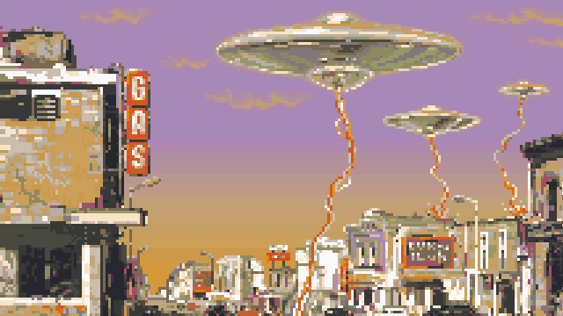
GAME ELEMENTS
Title: CAMPUS MADNESS: STUDENT STRIKE FORCE
Save The University... Save the World!
Genre:
Action/Adventure,
Some RPG elements

Slide 5
GAME ELEMENTS
Platform: Computer (Windows/Mac)
Keyboard and Mouse
Internet Connection
Market: Gamers 13+, Fast-paced Action fans
Game has cartoon violence
Goal: Defeat the Final Boss and Save the World, get the Highest Score

Slide 6
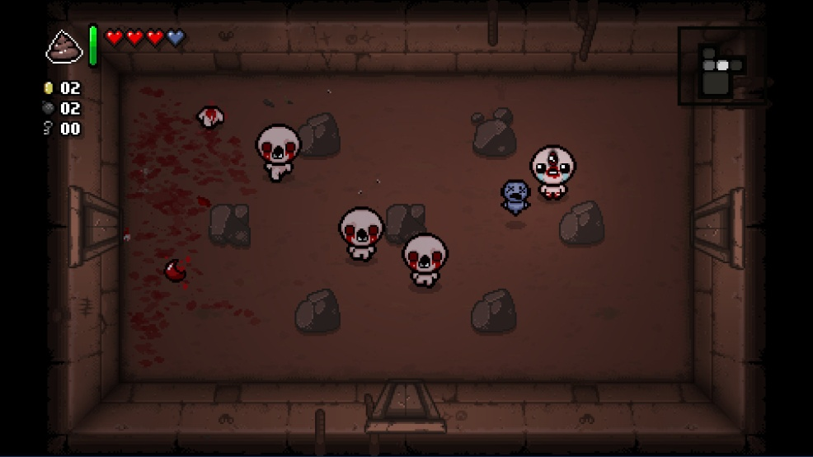
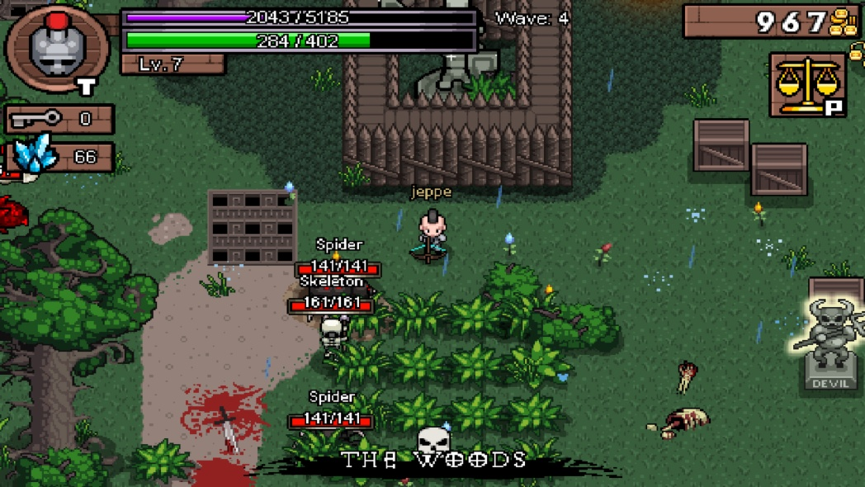
GAME ELEMENTS
Plays like: Binding of Isaac meets Hero Siege

Slide 7
MECHANICS - COMBAT
2D, Top-down Combat (up to 2 Players)
Fast-paced action
Combat similar to Binding of Isaac and top-down games from Zelda franchise
Multiple Character types, each different characteristics and gameplay styles
Up to 2 Players, Co-Op gameplay

Slide 8
MECHANICS - COMBAT
Character Types:
Melee Brawler: High attack and health, low range and speed
Melee Assassin: Lower attack, higher speed and evasiveness
Ranged Marksman: Average stats, can attack from a distance
Mage: Low health, but can attack multiple enemies at once (AoE)
Support: Low attack, high health, can boost the stats of allies

Slide 9
MECHANICS - COMBAT
Traditional character archetypes, but re-imagined to fit with game’s theme
Simple combat, each character with 3 attacks
2 regular attacks and 1 special attack that must be charged up
Brawler example:
1) Punch
2) Head butt
Special) Kick all Enemies in front of you

Slide 10
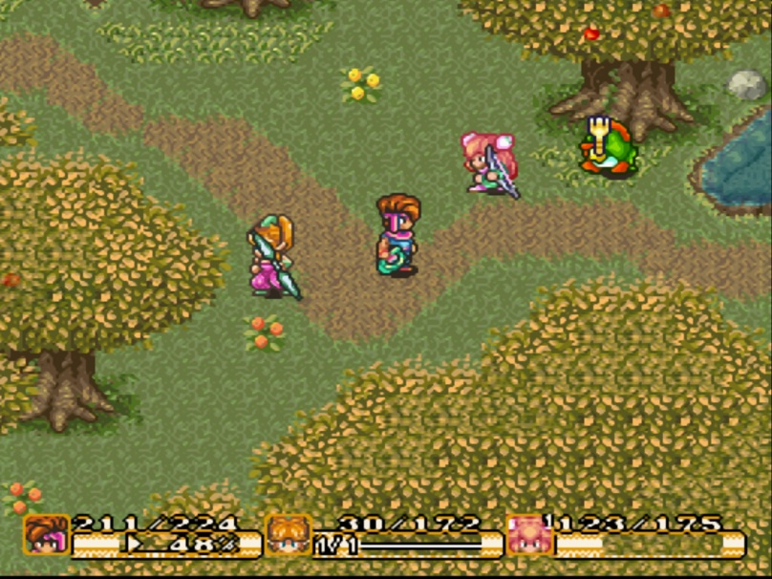
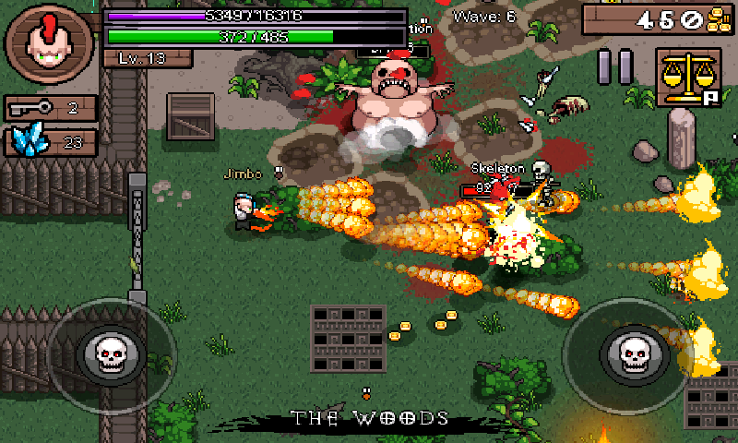
MECHANICS - COMBAT
Examples

Slide 11
MECHANICS – PROCEDURAL DUNGEON
Game contains 5 themed levels
Each level is a “dungeon” made up of a number of rooms that increases each level
Must defeat all waves of enemies to clear a room and move on
Some doors require keys found in rooms or dropped by enemies
2 Game Modes: Normal and Hardcore

Slide 12
MECHANICS – PROCEDURAL DUNGEON
The game will be different every time you play it
Rooms are all similar but have differences
Each play through chooses a set of rooms for each dungeon
Enemies spawn randomly in each room
“Concord” University has different room themes
Ex: Portal to the Underworld (FG Building)
Each Level progresses the story, ends with a Boss Fight

Slide 13
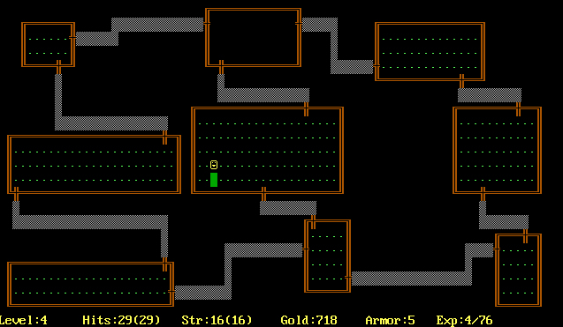
MECHANICS – PROCEDURAL DUNGEON
Examples

Slide 14
MECHANICS – RPG ELEMENTS
Each Character Type has predefined set of attributes
Damage, Health, Defence, Speed...
After levels are completed, Player has option to increase one of these attributes
Can customize characters to your preference
Randomly found Items to increase attributes
Example: Hot Pepper increases attack for 2 minutes

Slide 15
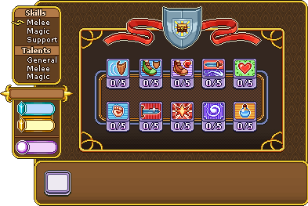
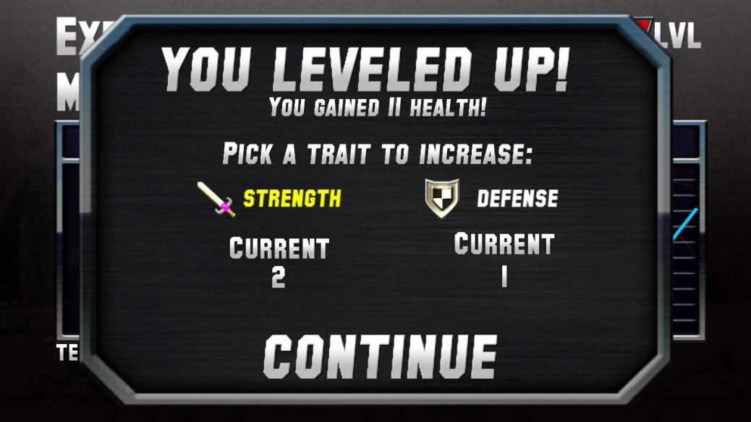
MECHANICS – RPG ELEMENTS
Examples

Slide 16
MECHANICS - SCORING
Goal of game is to defeat Final Boss
Sub goal is to get the highest score
Defeating enemies increases your score
Consecutive enemies defeated without taking damage gives you a score multiplier
Randomly dropped items increase your score
Score bonus based on time taken to complete dungeon
Normal Mode vs Hardcore Mode
Top 10 Scores tracked by the game
Increased replayability, competition
Scoring system rewards skill

Slide 17
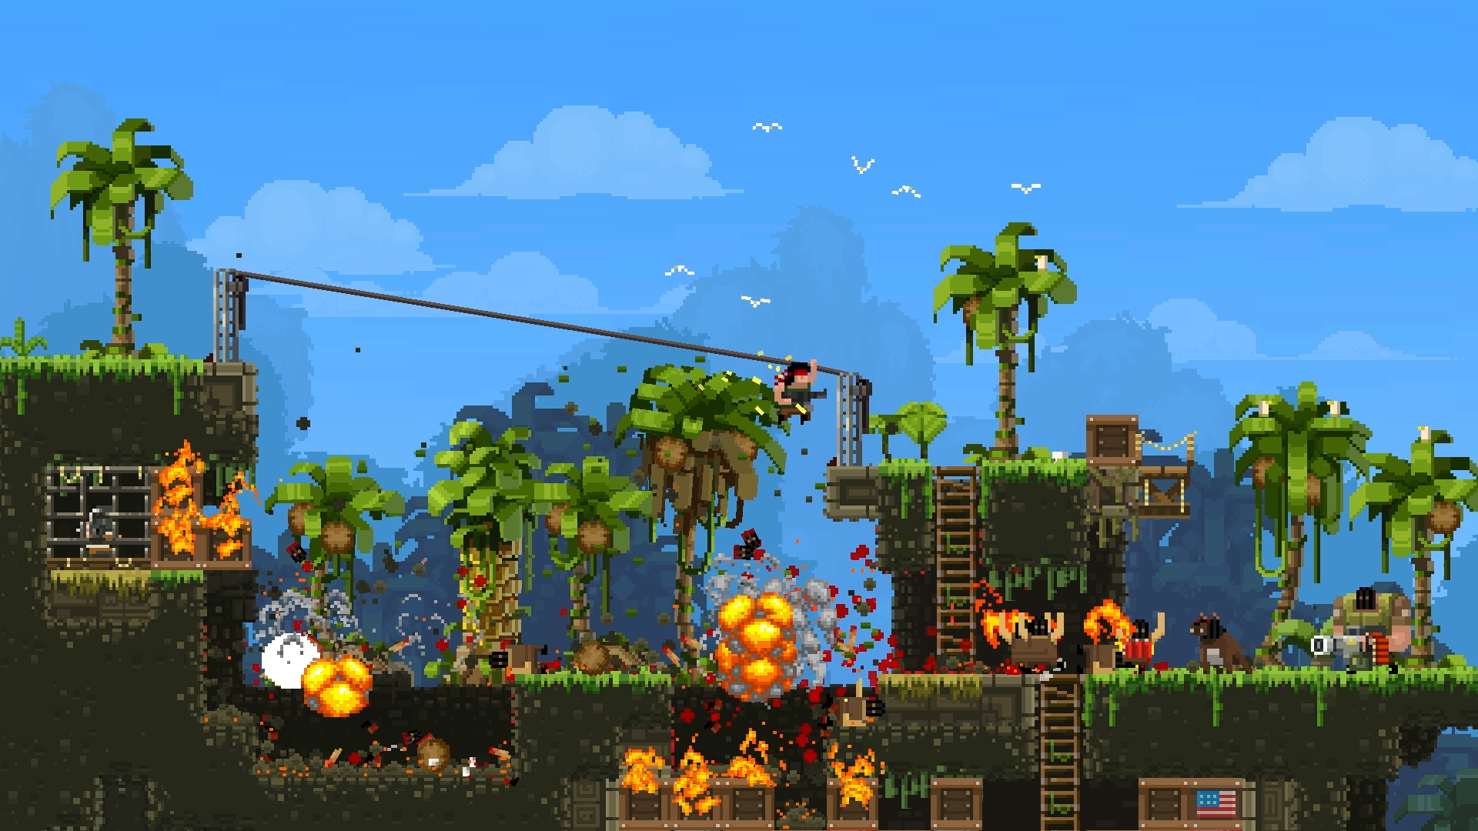
REFERENCE ART
Broforce

Slide 18
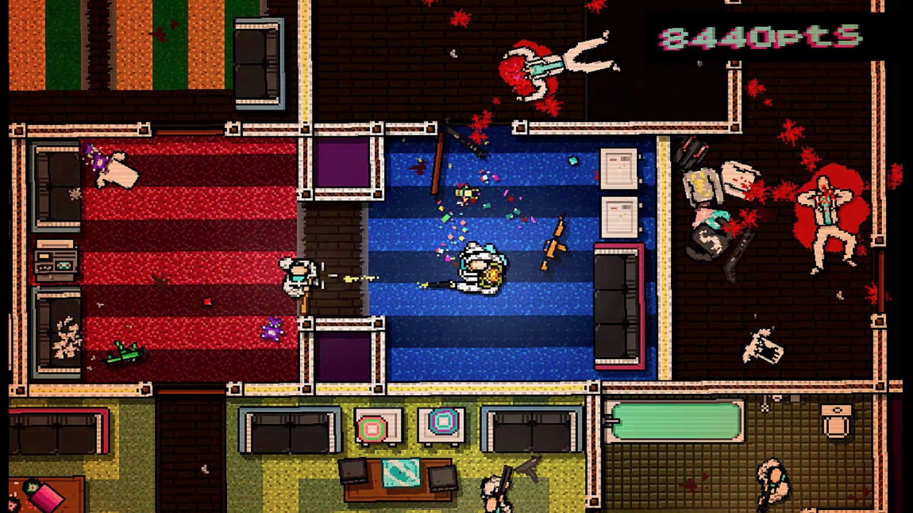
REFERENCE ART
Hotline Miami

Slide 19
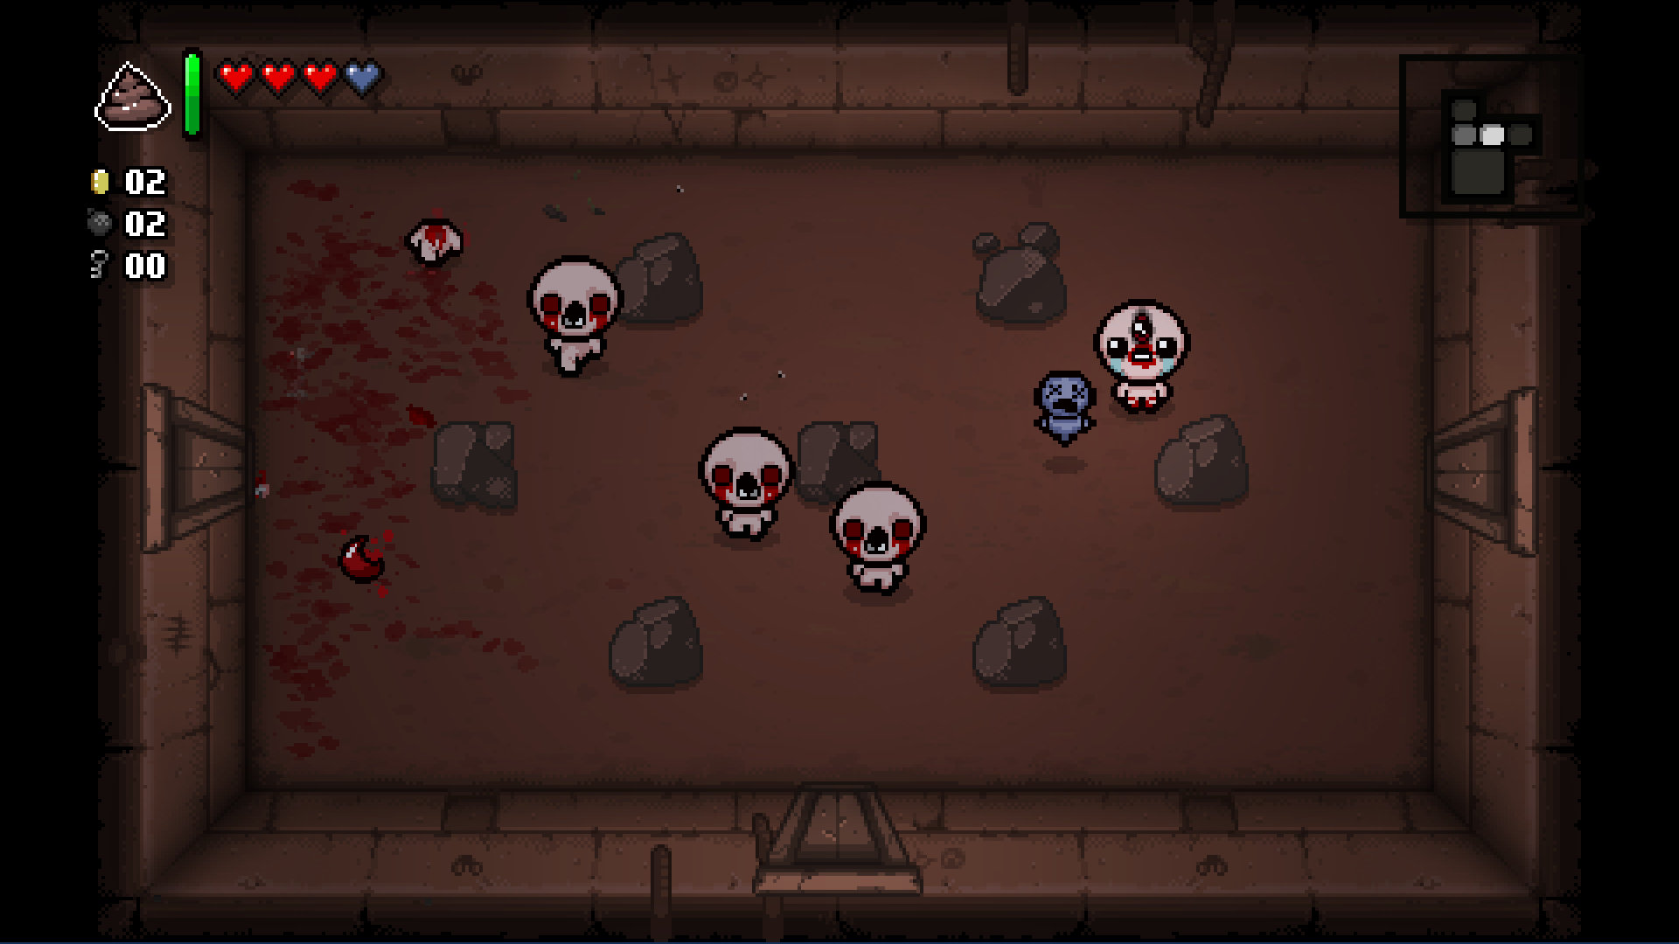
REFERENCE ART
Binding of Isaac

Slide 20
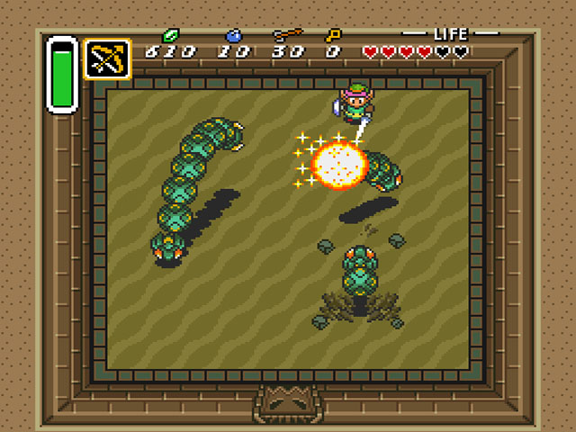
REFERENCE ART
Legend of Zelda: Link to the Past

Slide 21
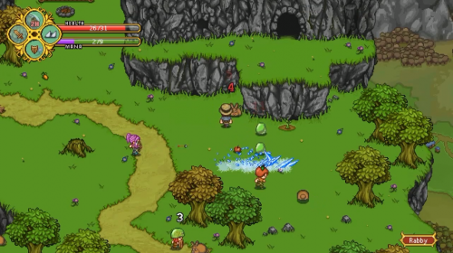
REFERENCE ART
Secrets of Grindea

Slide 22
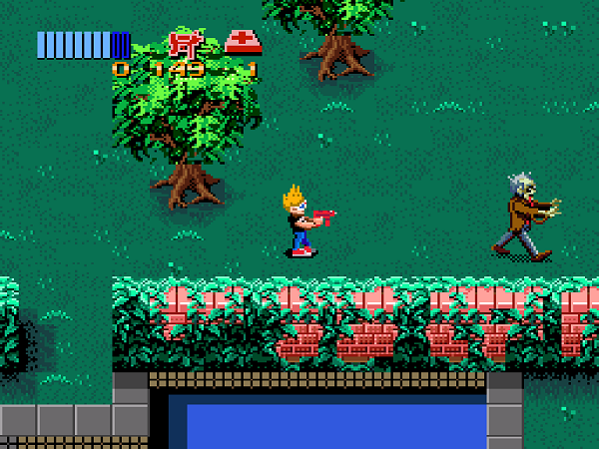
REFERENCE ART
Zombies ate my Neighbors

Slide 23
RELATED GAMES
The Binding of Isaac: Rebirth
Top-Down dungeon “roguelike” crawler (hardcore)
Characters with different attributes/game play mechanics
Procedural dungeon with boss fights
High score challenge
Campus Madness: Student Strike Force
Procedural dungeon with boss fights and storyline
Distinct character classes, more developed co-op play
Normal mode and Hardcore mode

Slide 24
RELATED GAMES
Hotline Miami
Top-down “retro” shooter, fast paced action
Masks and weapons that change combat skills
High level of skill needed, physics and using the environment to your advantage
Final boss with High Score as the main objective
Campus Madness: Student Strike Force
Similar retro feel and fast-paced action
Similar scoring mechanics and rewarding skillful play
Focused more on classes than mechanic changing masks and weapons

Slide 25
RELATED GAMES
Hero Siege
Top-down RPG, “roguelike”, similar to Diablo
Enemy waves and bosses at end of each level
Multiple classes with different mechanics, and level-up based progression
Procedural maps and co-op game play
Campus Madness: Student Strike Force
Similar class system and level progression
Enemy waves and bosses with co-op play
Normal mode to allow for more casual game play

